Slide 1
Unit 6: Solutions
Concentration
& Dilution

Slide 2
Concentration
Concentration refers to the amount of solute dissolved in a specific amount of solvent.
Concentrated and dilute are qualitative terms we use to describe concentration. Dilute means there is not a lot of solute in the solution and concentrated means there is a lot of solute in the solution.
Common concentrations are molarity, molality, ppm, and ppb.

Slide 3
Molarity
This is the number of moles of solute dissolved in one litre of solution.
The formula for molarity is as follows:
C = _n_
V
n = # moles of solute
V = volume of solution in litres
c = concentration in moles per litre (M)

Slide 4
Ex. If a teaspoon (5.0mL) of a 0.50 M solution of NaCl was evaporated, how many moles of sodium chloride would be left? What mass of NaCl would be left?

Slide 5
Ex. Antifreeze is a solution of ethylene glycol, C₂H₆O₂, in water. If 4.50 L of antifreeze contains 2.00 kg of ethylene glycol, what is the concentration of the solution?

Slide 6
Solubility Curves
There are charts and tables available that we can use to get an idea of how soluble a certain solute is in a certain solvent. Solubility curves tell us what mass of solute will dissolve in 100g of water over a range of temperatures.

Slide 7
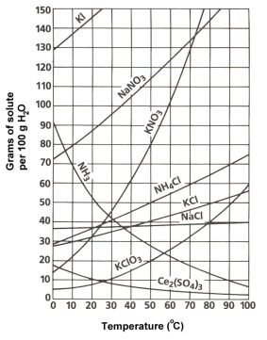
You'll notice that for most substances, solubility increases as temperature increases. In solutions involving liquids and solids typically more solute can be dissolved at higher temperatures.
Ex. At 30°C approximately ________ of KClO₃ will dissolve in 100g of water. If the temperature is increased to 80°C, approximately ______ of the substance will dissolve in 100g (or 100mL) of water.

Slide 8
Ex. What mass of solute will dissolve in 100mL of water at the following temperatures. Also determine which of the three substances is most soluble in water at 15°C
1. | KNO₃at 70°C
2. | NaCl at 100°C
3. | NH₄Cl at 90°C

Slide 9
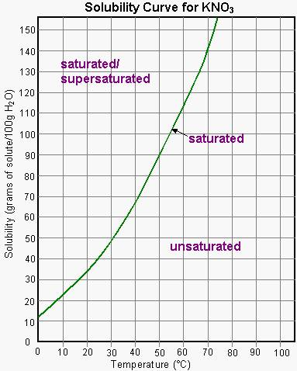
On a solubility curve, the lines indicate the concentration of a saturated solution - the maximum amount of solute that will dissolve at that specific temperature. The molar concentration of the substance can be calculated.
The values on the graph below a curve represent unsaturated solutions - more solute could be dissolved at that temperature. Values above a curve represent supersaturated solutions, a solution which holds more solute that can normally dissolve in that volume of solvent.

Slide 10
Ex 3. Determine the molarity of a saturated NaCl solution at 25°C.

Slide 11
Ex 4. What term - saturated, unsaturated, or supersaturated - best describes:
a solution that contains 70g of NaNO₃ per 100 mL H₂O at 30°C
a solution that contains 60g of dissolved KCl per 100 mL H₂O at 80°C

Slide 12
Standard solution:
A standard solution is a solution of a known concentration. This means it has a precise mass of solute in a specific volume of solution.
Standard solutions are used in experiments where the concentration of a solution must be known.
We use volumetric flasks to prepare standard solutions as they have a small margin of error when compared to other pieces of lab equipment. Volumetric flasks come in a variety of sizes (volumes).

Slide 13
Standard solution:
To prepare a standard solution we follow the following steps:
Calculate the required mass of solute needed using the volume and concentration you want to end up with.
Weigh out the mass of the solute needed and add it to a volumetric flask of the appropriate size.
Dissolve the solid in pure water using less than half of the final solution volume.
Once the solute is dissolved, add the rest of the water. Be sure to use a medicine dropper for the final few milliliters of water. Use the calibration line to set the meniscus in the appropriate spot.

Slide 14
Standard solution:
Ex. Describe the preparation of 2.000 L of a standard aqueous solution containing 0.1000 mol/L potassium nitrate.
To prepare the solution we place_______________ g of KNO₃ in a 2.000 L volumetric flask.___________________ the required amount of water is added. When all the potassium nitrate is dissolved, the solution is diluted with the remaining water.

Slide 15
Dilution Calculations:
When making a solution in chemistry laboratories you usually only have access to substances with high concentration solutions (called stock solutions) and are then required to dilute the stock solutions. A calculation needs to be completed in order to determine the amount of distilled water that needs to be added to a certain volume of stock solution in order to create the desired concentration.
Since the number of moles of solute in a solution does not change when you dilute it, the equation for dilution is as follows:
V₁ C₁ = V₂ C₂
before after

Slide 16
Ex. Water is added to 200.mL of 2.40M ammonia cleaning solution (NH₃), until the final volume is 1.00L. Find the molar concentration of the final diluted solution.

Slide 17
Ex . What volume of concentrated sulphuric acid (containing 18.0 M H₂SO₄) is required to prepare 5.00 L of 0.150 M aqueous sulphuric acid solution by dilution with water?

Slide 18
Ion Concentration:
Consider a 0.20M aqueous solution of sodium carbonate. The sodium carbonate will be completely dissociated into ions:
The concentration of the sodium ions can be calculated using the conversion factors from the balanced equation (similar to mol- mol stoichiometry). Remember: concentration is represented by using square brackets.

Slide 19
Ex. What are the concentrations of the ions in an aqueous solution containing 0.15 mol/L iron(III) nitrate?

Slide 20
Ex. 250mL of 0.30M K₂SO₄ and 250mL of 0.80M MgCl₂ are mixed and no reaction results. What is the concentration of each substance in the final solution, and the concentration of each individual ion?

Slide 21
See Concentration and Dilution Assignment

